Slide 1

About the Presentations
The presentations cover the objectives found in the opening of each chapter.
All chapter objectives are listed in the beginning of each presentation.
You may customize the presentations to fit your class needs.
Some figures from the chapters are included. A complete set of images from the book can be found on the Instructor Resources disc.

Slide 2
A+ Guide to Managing & Maintaining Your PC, 8th Edition
Chapter 1
First Look at Computer Parts and Tools

Slide 3
Objectives
Learn about the various parts inside a computer case and how they connect together and are compatible
Learn how to protect yourself and the equipment against the dangers of electricity when working inside a computer case
Learn about tools you will need as a PC hardware technician and safety precautions when working around computer equipment

Slide 4
What’s Inside the Case
Computer Case
Sometimes called “chassis”
Holds
Power supply, motherboard, processor, memory modules, expansion cards, hard drive, optical drive, other drives
Tower case – sits upright and can hold several drives
Desktop case – lies flat and sometimes holds monitor
Laptop case – mobile
All-in-one case – used with all-in-one computer

Slide 5
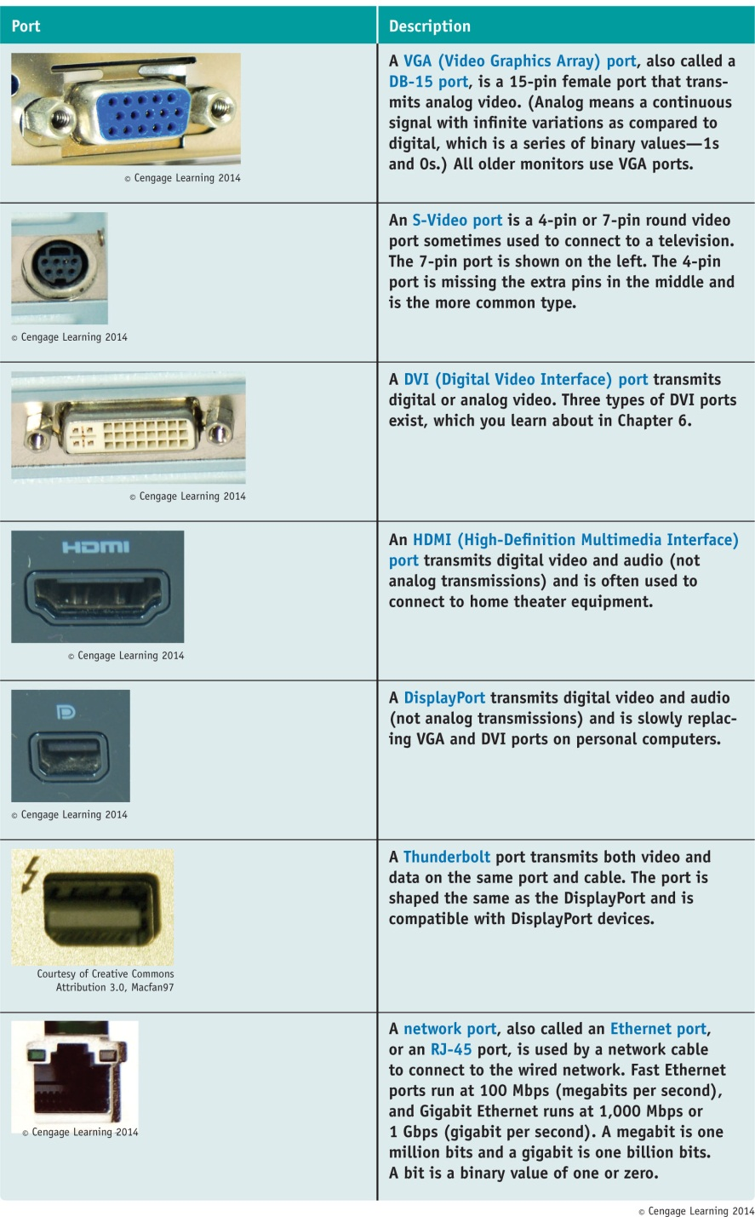
Table 1-1 Ports used with
laptop and desktop
computers

Slide 6
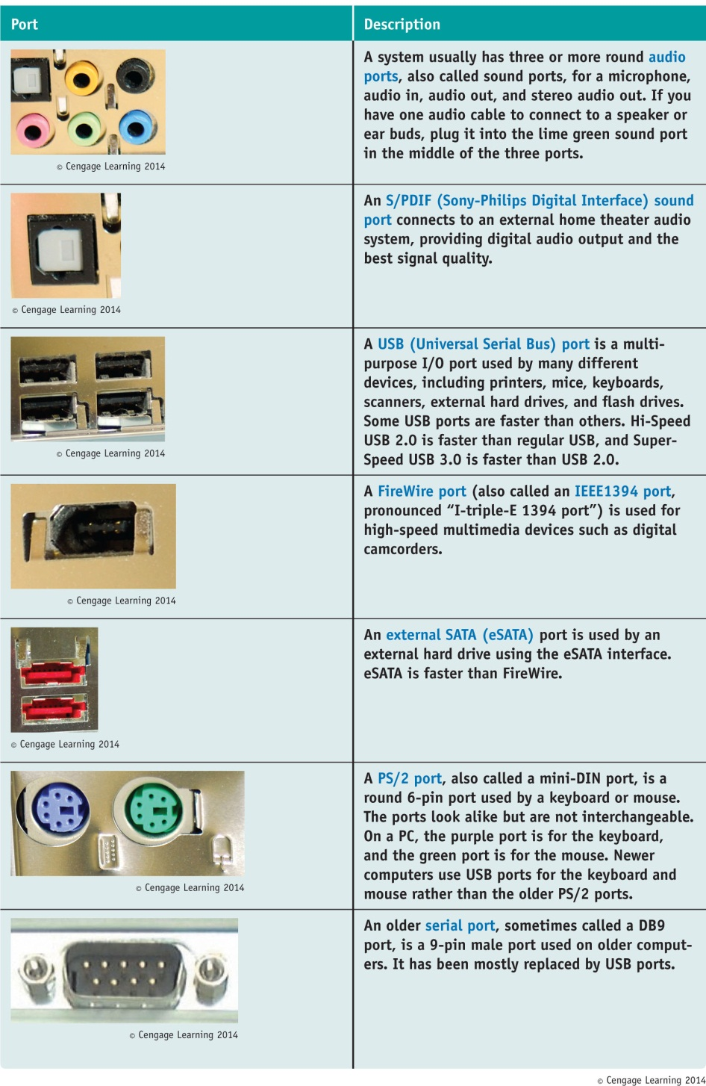
Table 1-1 Ports used with
laptop and desktop
computers

Slide 7
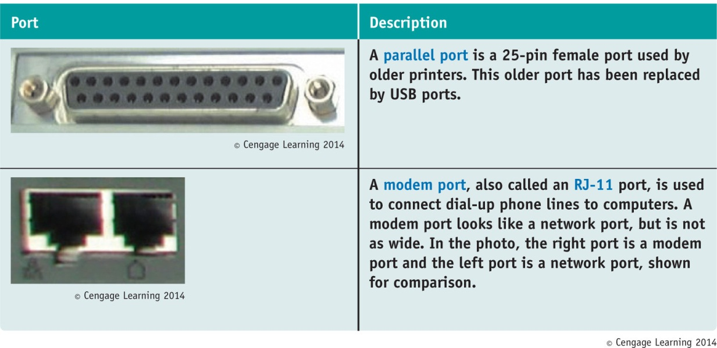
Table 1-1 Ports used with laptop and desktop computers

Slide 8
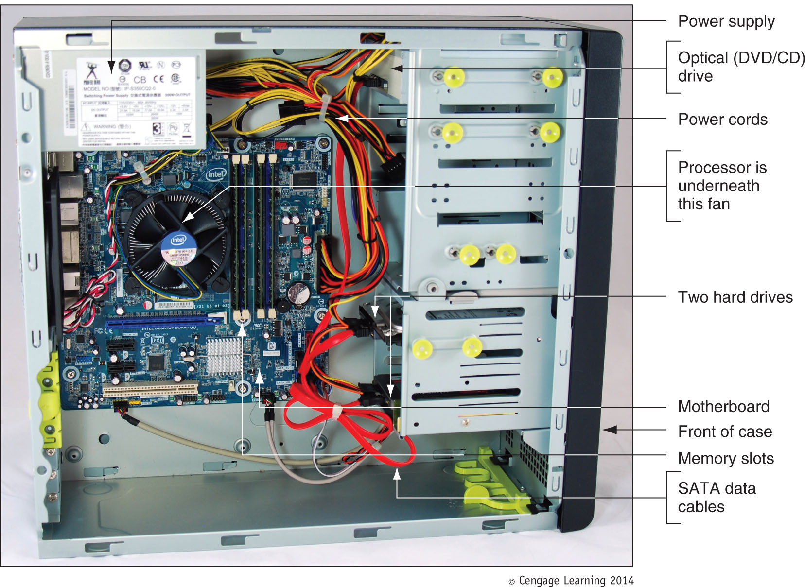
Figure 1-2 Inside the computer case

Slide 9
What’s Inside the Case
Motherboard – sometimes called system board
Largest and most important circuit board
Processor – central processing unit (CPU)
Processes most of the data and instructions for the entire system
CPUs generate heat and require a heat sink and fan (together called the processor cooler)
A heat sink consists of metal fins that draw heat away from a component

Slide 10
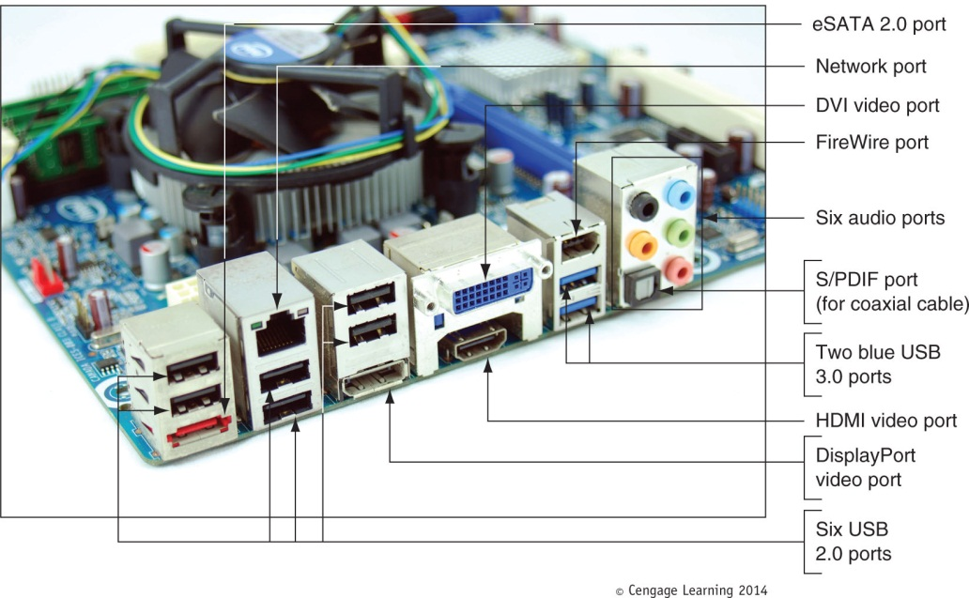
What’s Inside the Case
Expansion cards - also called adapter cards
A circuit board that provides more ports than those provided by the motherboard
Today, most ports are provided by motherboards
Figure 1-4 Ports provided
by a motherboard

Slide 11
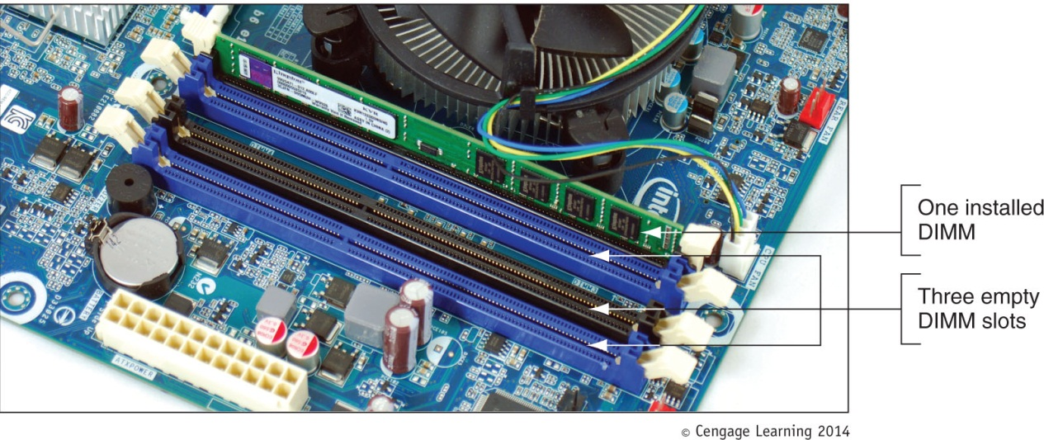
What’s Inside the Case
Memory modules – random access memory (RAM)
Temporary storage for data and instructions as they are being processed by the CPU
Dual inline memory module (DIMM) slots hold memory modules
Figure 1-6 A DIMM
holds RAM and is
mounted directly on
a motherboard

Slide 12
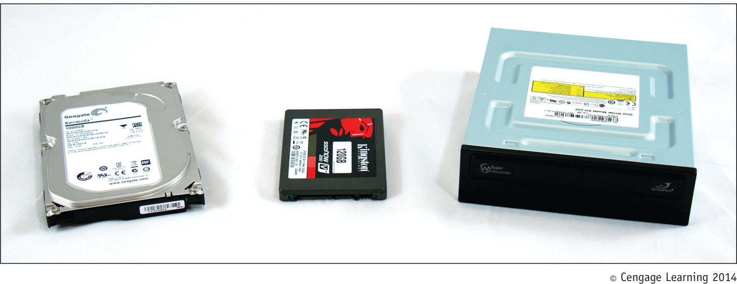
What’s Inside the Case
Hard drives and other drives
Hard drives may also be called hard disk drive (HDD)
Permanent storage used to hold data and programs
Other drives include: optical drive and tape drive
Figure 1-7 Two types of hard drives (larger magnetic drive and smaller solid-state
drive) and a DVD drive

Slide 13
What’s Inside the Case
Power supply – also called power supply unit (PSU)
Receives and converts house current so that components inside the case can use it
Most come with a dual-voltage selector switch
Allows switching input voltage from 115V to 220V

Slide 14
Form Factors Used by Computer Cases, Power Supplies, and Motherboards
Form factors: standards that describe the size, shape, screw hole positions, and major features of computer cases, power supplies, and motherboards
Necessary so that all will be compatible with each other
Two form factors used by most desktop and tower computer cases and power supplies:
ATX
Mini-ATX

Slide 15
Form Factors Used by Computer Cases, Power Supplies, and Motherboards
ATX (Advanced Technology Extended)
Most commonly used form factor today
Originally developed by Intel in 1995
It is an open, nonproprietary industry specification
An ATX power supply has a variety of power connectors
Power connectors have evolved because new technologies require more power
Common ATX power connectors are listed on the following slides

Slide 16
Form Factors Used by Computer Cases, Power Supplies, and Motherboards
20-pin P1 connector: used by the first ATX power supplies and motherboards
4-pin and 8-pin auxiliary connectors: used to provide and additional 12 V of power for evolving CPUs
24-pin or 20+4-pin P1 connector: the older 20-pin P1 connector still worked in this connector
Supported the new PCI Express slots
6-pin and 8-pin PCIe connectors: connect directly to the video card
Video cards draw the most power in a system

Slide 17
Form Factors Used by Computer Cases, Power Supplies, and Motherboards
MicroATX form factor
Major variation of ATX
Reduces total cost of a system by:
Reducing number of expansion slots on motherboard
Reducing power supplied to the board
Allowing for a smaller case size
Uses a 24-pin P1 connector
Not likely to have as many extra wires and connectors as those on the ATX power supply

Slide 18
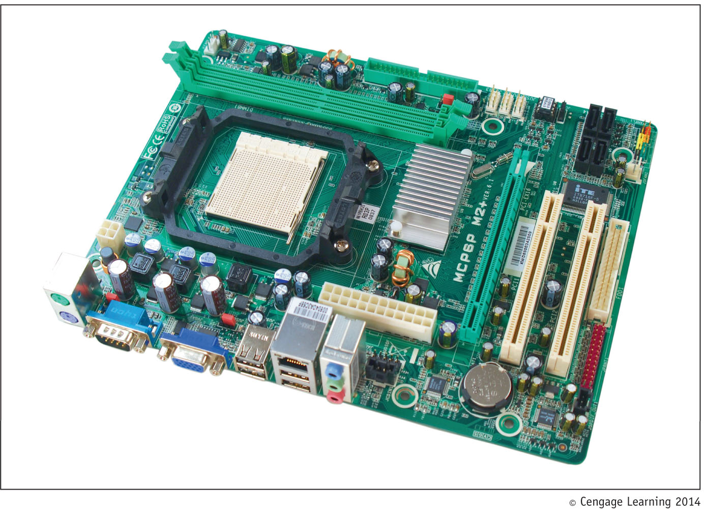
Figure 1-18 This MicroATX motherboard by Biostar is designed to
support an AMD processor

Slide 19
Drives, Their Cables, and Connectors
Hard Drives
Two standards:
Serial ATA standard (SATA)
Used by most drives today
Parallel ATA (PATA) – slower than SATA
Also called IDE interface
Uses 40-pin ribbon cable and connector
Two connectors on a motherboard for two data cables
Accommodates up to four IDE devices
Uses a 4-pin power connector called a Molex power connector

Slide 20
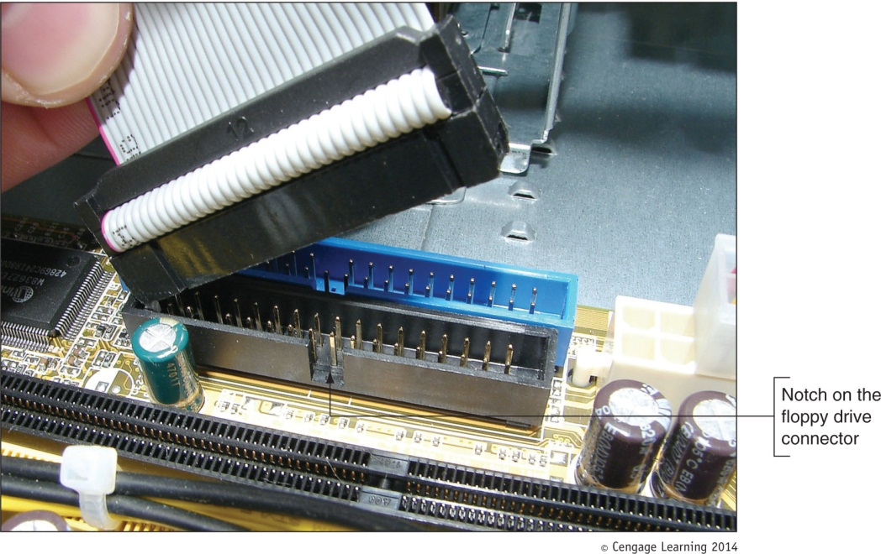
Drives, Their Cables, and Connectors
Floppy drive
3.5-inch disk holding 1.44 MB of data
Uses a 34-pin twisted cable
Can hold up to two drives
Figure 1-28 The notch on the side of
this floppy drive connector allows the
floppy drive cable to connect in only
one direction

Slide 21
Protecting Yourself and Equipment Against Electrical Dangers
Important to understand electricity and how to protect yourself and equipment against it
Must learn to prevent getting shocked or damaging a component

Slide 22
Measures and Properties of Electricity
Alternating current (AC): oscillates between negative and positive voltage
House current is AC and oscillates 60 times in one second
Direct current (DC): travels in one direction
Type of current used by most electronic devices
Rectifier: a device that converts AC to DC
Inverter; a device that converts DC to AC
Transformer: devices that changes the ratio of voltage to current

Slide 23
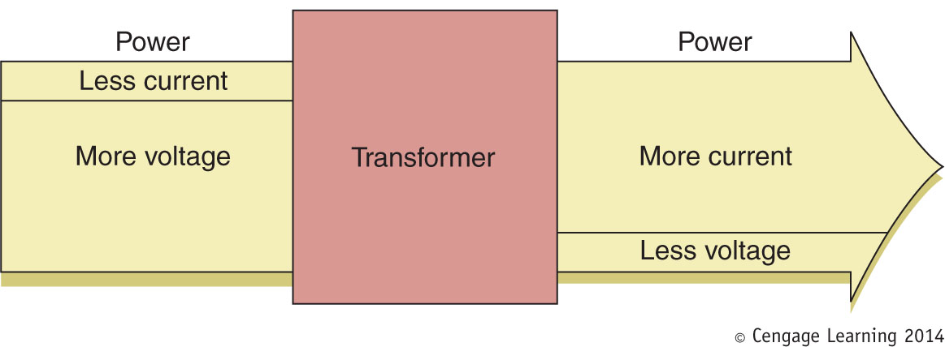
Figure 1-30 A transformer keeps power constant but changes the
ratio of current to voltage

Slide 24
Measures and Properties of Electricity
AC travels on a hot line from a power station
AC returns to the power station on a neutral line
When AC follows an unintended path (one with less resistance) a short can occur
Short: a sudden increase in flow that can create a sudden increase in temperature
The neutral line is grounded to prevent uncontrolled electricity in a short
Grounding: the line is connected directly to the earth, so that electricity can flow into the earth

Slide 25
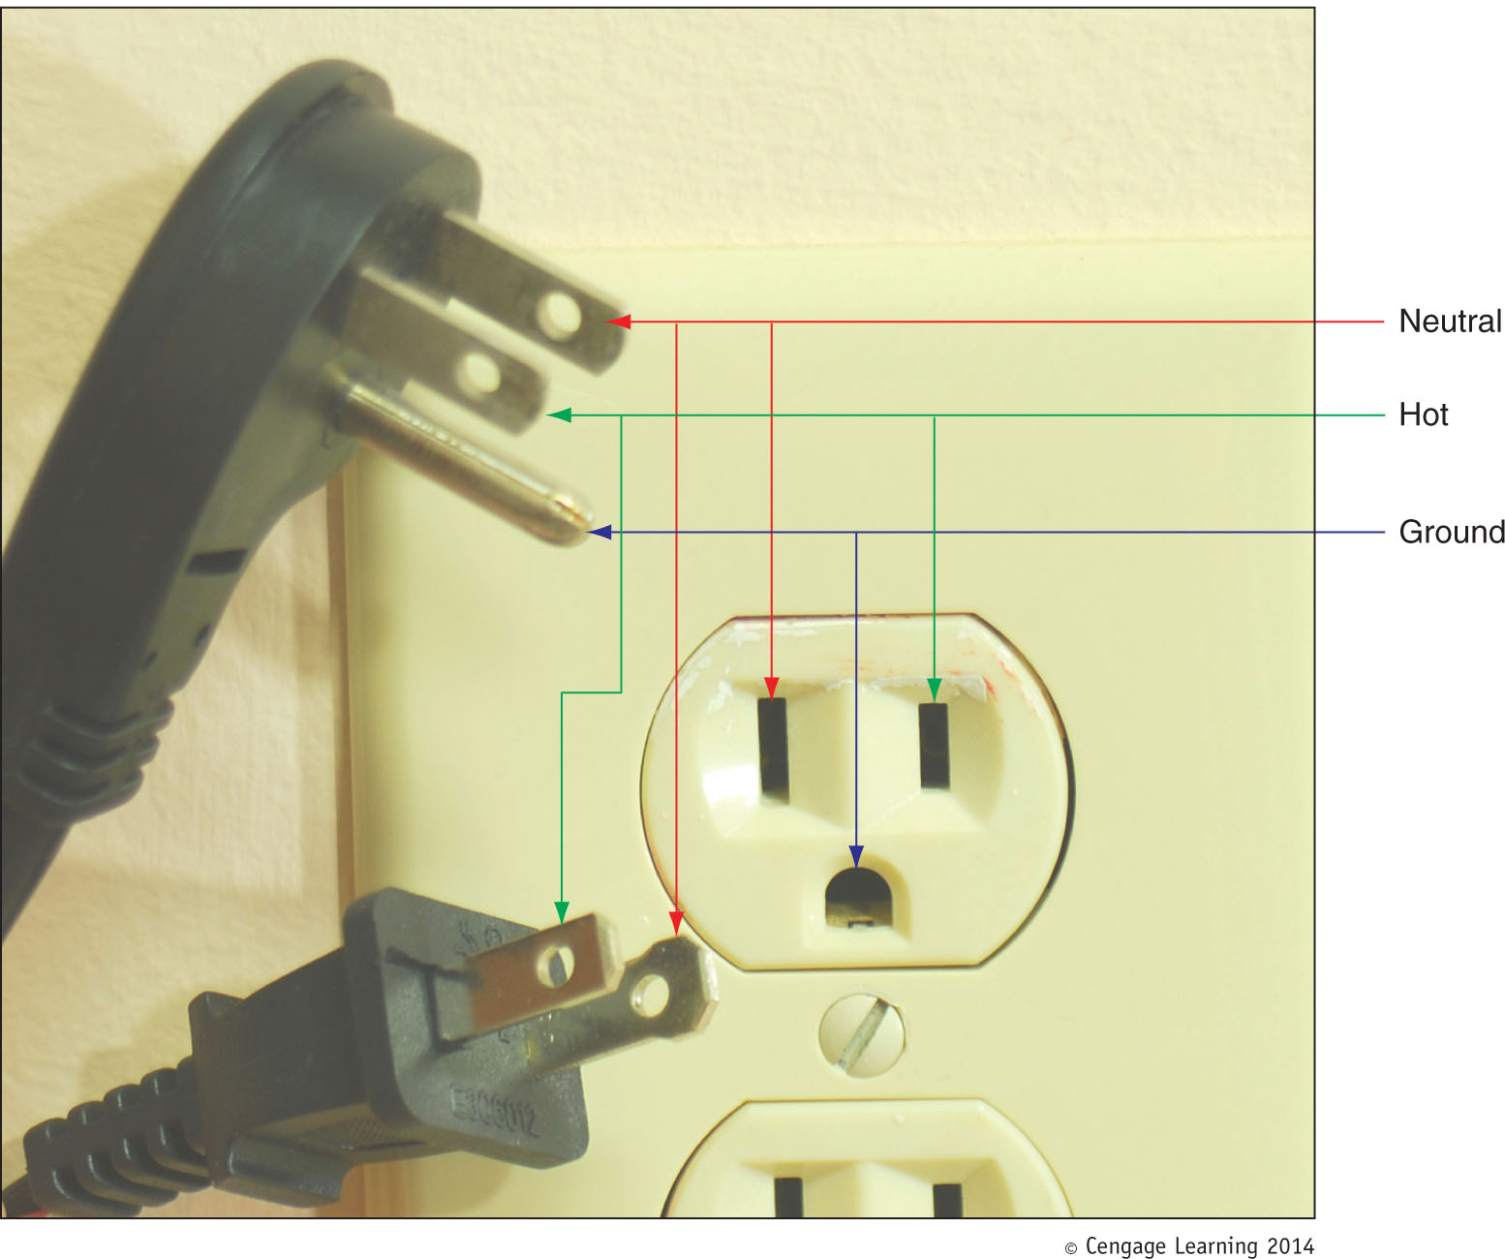
Figure 1-31 A polarized plug showing hot and neutral, and a three-prong plug
showing hot, neutral, and ground

Slide 26
Protect Yourself Against Electrical Shock and Burns
When working with any electrical device, disconnect power if you notice a dangerous situation that might lead to electrical shock or fire.
Potential dangers might include:
Power cord is frayed or damaged
Water or other liquid is spilled near
Device has been dropped or physically damaged
Smell a strong electronics odor
Power supply or fans make a whining noise
Smoke is observed or case feels unusually warm

Slide 27
Protect Yourself Against Electrical Shock and Burns
When working on sensitive low-voltage equipment such as a motherboard or processor:
Ground yourself with an anti-static grounding bracelet connected to a ground
When working with power supplies, printers, and CRT monitors that contain capacitors:
Do not ground yourself because power can flow through you to the ground and you may get shocked
Power supplies and monitors are considered a field replaceable unit (FRU), which means you are expected to know how to replace, not how to repair it

Slide 28
Protect Yourself Against Electrical Shock and Burns
Never use water to put out a fire (water is a conductor)
Use a fire extinguisher that is rated to put out electrical fires
Fire extinguisher ratings:
Class A: can use water to put out fires caused by wood, paper, or other combustibles
Class B: can put out fires caused by liquids such as gasoline, kerosene, and oil
Class C: use nonconductive chemicals to put out a fire caused by electricity

Slide 29
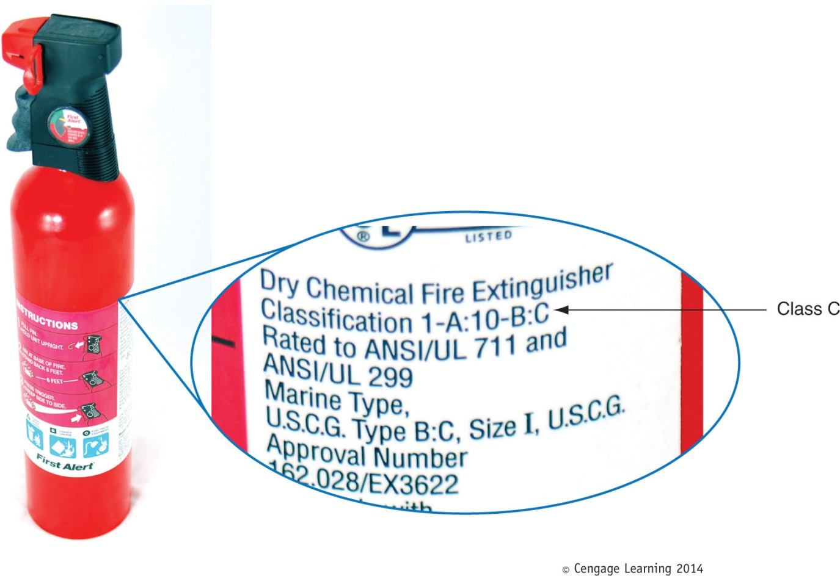
Figure 1-33 A Class C fire extinguisher is rated to put out electrical fires

Slide 30
Protect the Equipment Against Static Electricity or ESD
Electrostatic discharge (ESD): electrical charge at rest
When two objects with dissimilar electrical charges touch, electricity passes between them until charges are equal
ESD can cause two types of damage:
Catastrophic failure: destroys the component
Upset failure: damages the component so that it does not work well
Both types permanently affect the device

Slide 31
Protect the Equipment Against Static Electricity or ESD
To protect against EDS, always ground yourself with one or more of the following static control methods:
Ground bracelet: also called ESD strap, antistatic wrist strap, or ESD bracelet
Attach bracelet to the computer case to ground it
Ground mats: also called ESD mats
Often used by bench technicians who repair and assemble computers at workbenches or assembly lines
Static shielding bags: also called antistatic bags
Antistatic gloves: also called ESD gloves
Prevents ESD between you and a device when wearing

Slide 32
Protect the Equipment Against Static Electricity or ESD
Rule 1: When passing a circuit board or other component to another person, ground yourself and touch the other person before you pass it
Rule 2: Leave components inside antistatic bags until ready to use them
Rule 3: Work on hard floors, not carpet
Rule 4: Don’t work on a computer in a cold and dry atmosphere
Rule 5: Remove packing tape and cellophane from around work area (materials that attract ESD)
Rule 6: Keep components away from hair and clothing

Slide 33
Tools Used By a PC Repair Technician
Essential tools
Ground bracelet, ground mat, antistatic gloves
Flat-head screwdriver
Phillips-head or cross-head screwdriver
Torx screwdriver set (size T15)
Insulated tweezers
Extractor
OS recovery CD or DVD
Many other non-essential tools exists
Use a toolbox

Slide 34
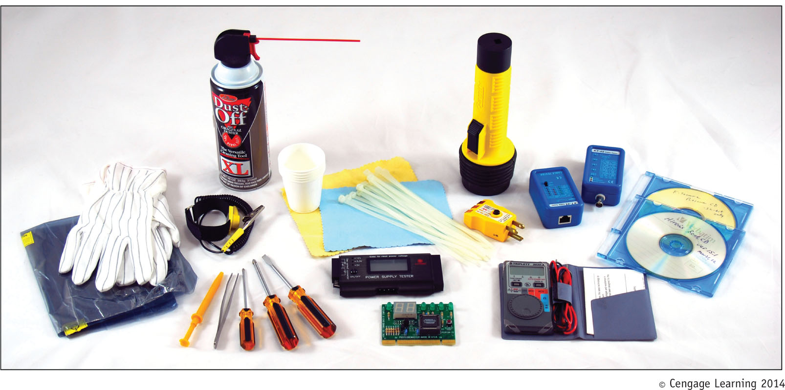
Figure 1-38 Tools used by PC support technicians when maintaining,
repairing, or upgrading computers

Slide 35
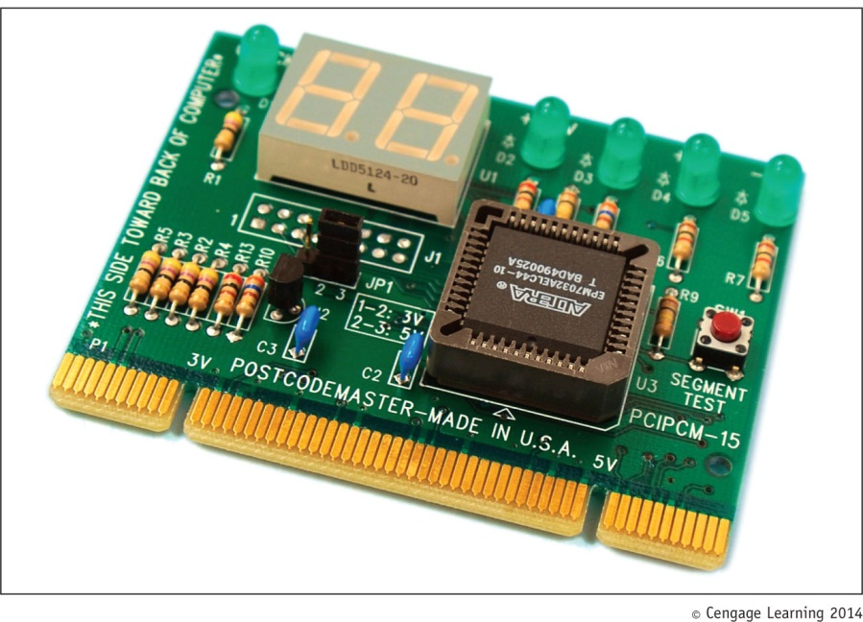
Post Diagnostic Cards
Post Diagnostic Cards
Helps discover, report computer errors and conflicts at power-on self test (POST)
Tests performed by startup BIOS
Figure 1-41 Post Code Master
Diagnostic card by Microsystems
Developments, Inc. installs in a
PCI slot

Slide 36
Post Diagnostic Cards
BIOS (basic input/output system)
Data and instructions stored on ROM chips
ROM BIOS chips: type of firmware
Three purposes served by motherboard ROM BIOS
System BIOS: manages simple devices
Startup BIOS: starts the computer
BIOS setup: changes motherboard settings
CMOS RAM: includes date, time, port configurations
Flash ROM
ROM chips that can be overwritten

Slide 37
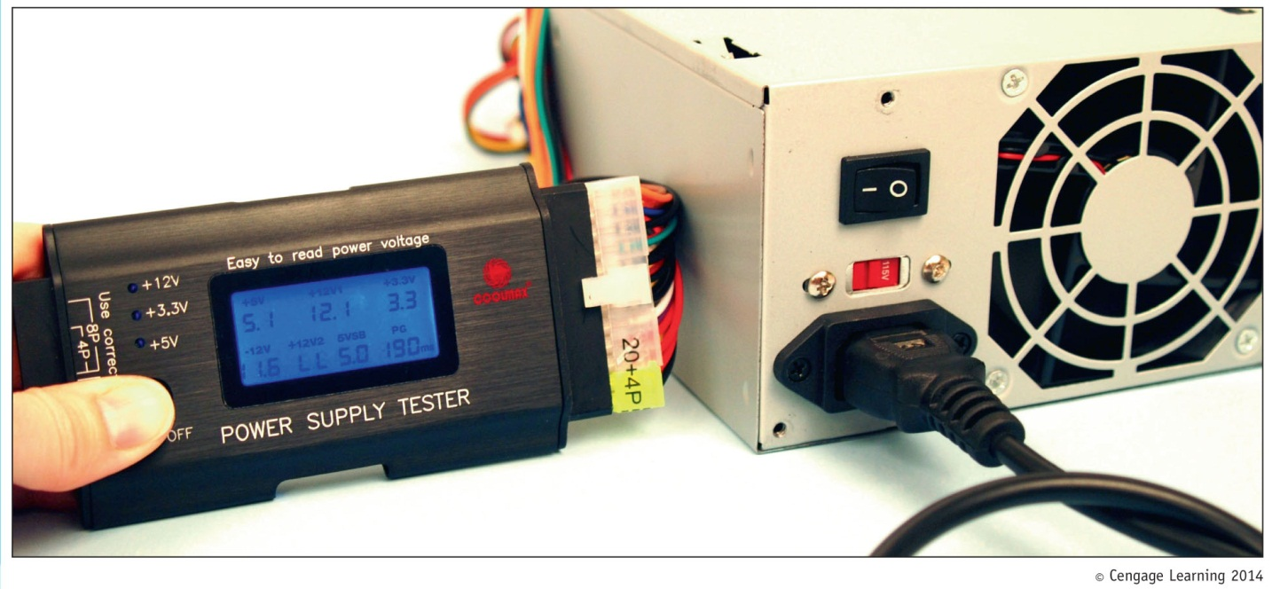
Power Supply Tester
Power Supply Tester
Measures output of each power supply connector
Figure 1-42 Use a power supply tester to test the output of each power
connector on a power supply

Slide 38
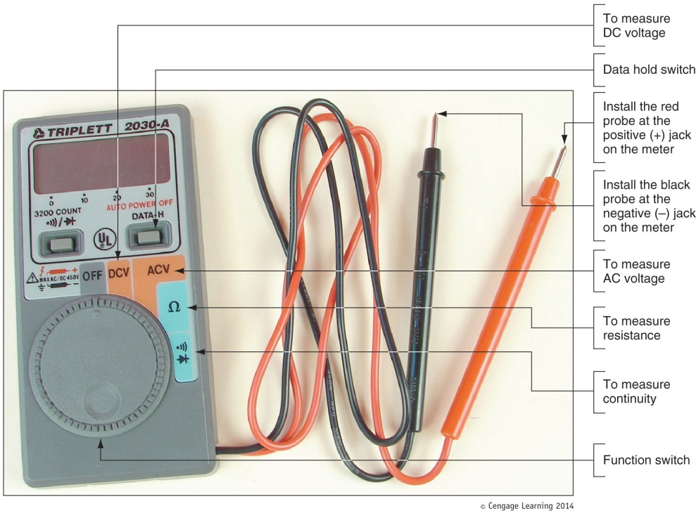
Multimeter
Multimeter
Measures several characteristics of electricity in a variety of devices
Figure 1-43 This digital multimeter
can be set to measure voltage,
resistance, or continuity

Slide 39
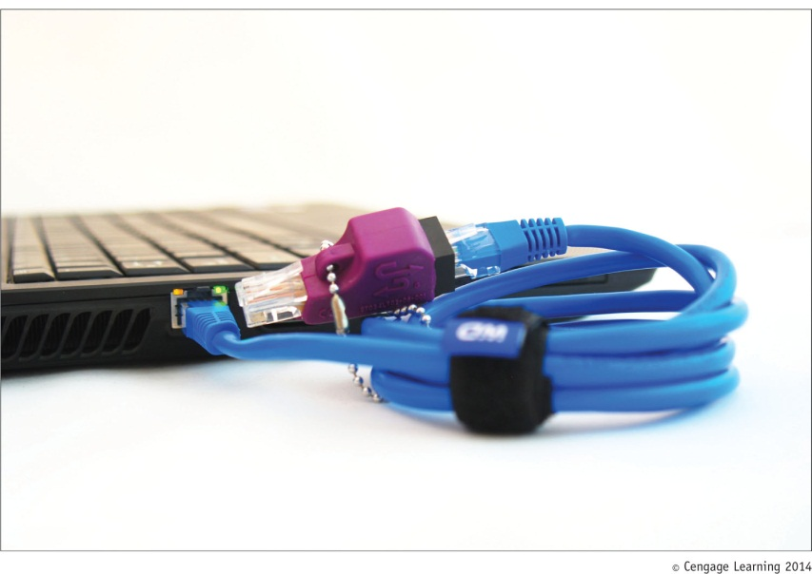
Loopback Plugs
Loopback plug
Used to test a port in a computer or other device to make sure the port is working
May also test the throughput or speed of port
Figure 1-44 A loopback plug testing
a network port and network cable

Slide 40
Proper Use of Cleaning Pads and Solutions
Most cleaning solutions contain flammable and poisonous materials
Take care when using them
A Material Safety Data Sheet (MSDS) explains how to properly handle substances such as chemical solvents and how to dispose of them
Usually comes packaged with chemical
Organizations may require an accident report be filled out if accident occurs using dangerous products

Slide 41
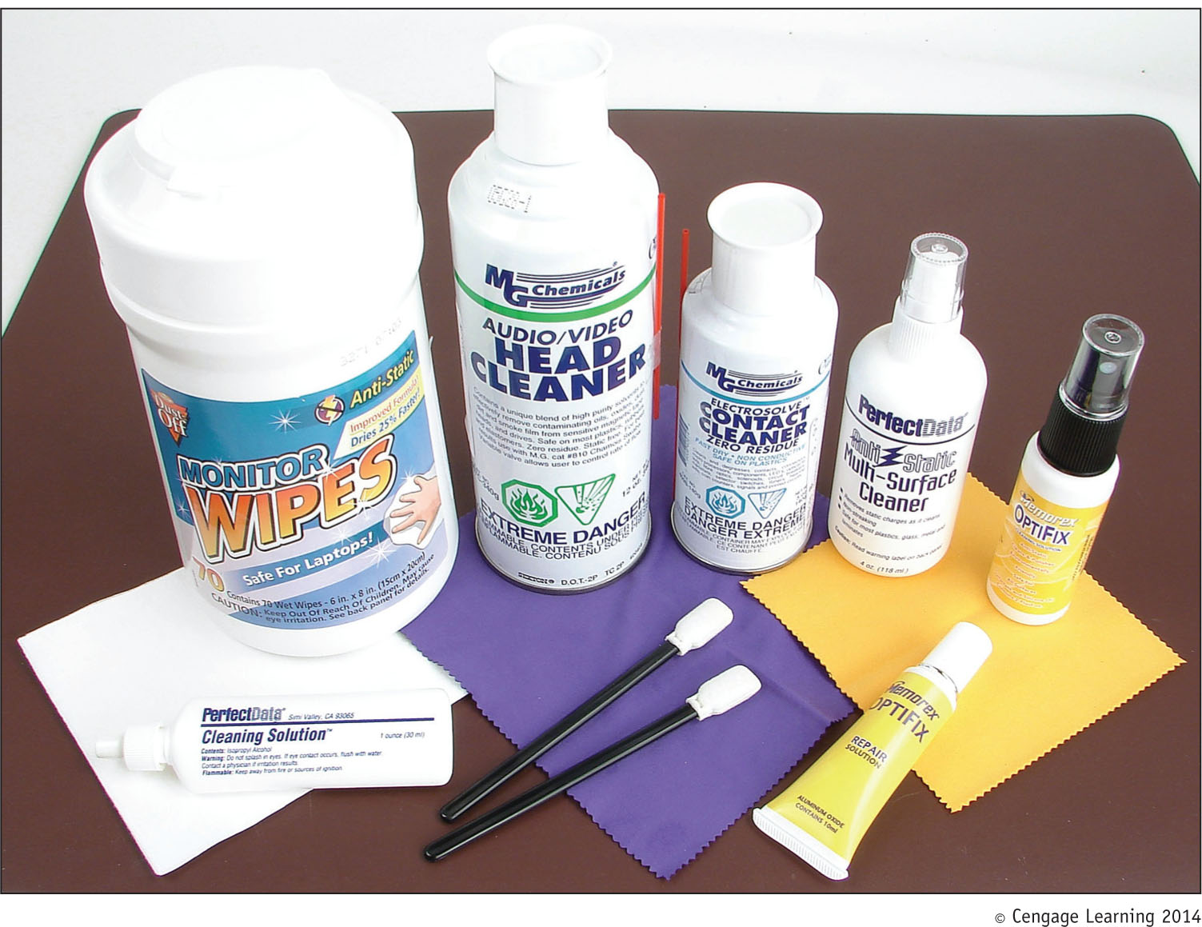
Figure 1-45 Cleaning solutions and pads

Slide 42
Managing Cables
Make sure cables are in a safe place
People can trip over cables left on floor (called a trip hazard)
If cable must be ran across a path or where someone sits:
Use a cable or cord cover

Slide 43
Lifting Heavy Objects
Follow these guidelines to avoid back injury:
Decide which side of object to face so that the load is most balanced
Stand close to the object with feet apart
Keep back straight, bend knees and grip load
Lift with legs, arms, and shoulders (not with back or stomach)
Keep the load close to your body and avoid twisting your body while holding it
To put object down, keep back straight and lower object by bending knees

Slide 44
Summary
Ports on a computer might include video, network, sound, S/PDIF, USB, FireWire, eSATA, and PS/2
Internal computer components include the motherboard, processor, expansion cards, DIMM modules, hard drive, optical drive, floppy drive, tape drive, and power supply
Form factors used by cases, power supplies, and motherboards are ATX and MicroATX
Power connectors include the 20-pin P1, 24-pin P1, 4-pin and 8-pin auxiliary motherboard, 4-pin Molex, 15-pin SATA, 4-pin FDD, 6-pin PCIe, and 8-pin PCIe

Slide 45
Summary
Standards used by hard drives and other drives to interface with motherboard and power supply are serial ATA (SATA) and parallel ATA (PATA)
Units used to measure electricity include volts, amps, ohms, joules, and watts
Microcomputers require DC which is converted from AC by the PC’s power supply
A power supply and CRT monitor contain dangerous charges even when unplugged
Never use water to put out an electrical fire

Slide 46
Summary
To protect against ESD use a ground bracelet, ground mat, antistatic bags, and antistatic gloves
Special tools a PC support technician might need include a POST diagnostic card, power supply tester, multimeter, and loopback plugs
A MSDS explains how to handle chemicals
Be careful not to lift a heavy object in a way that can hurt your back
Make sure cables are not trip hazards

